Slide 1

Conceptual Design ER Modeling

Slide 2
Agenda
Conceptual Modeling using ER Diagrams
ER symbols
Degree of relationships
Cardinality Constraints
Total and partial participation

Slide 3
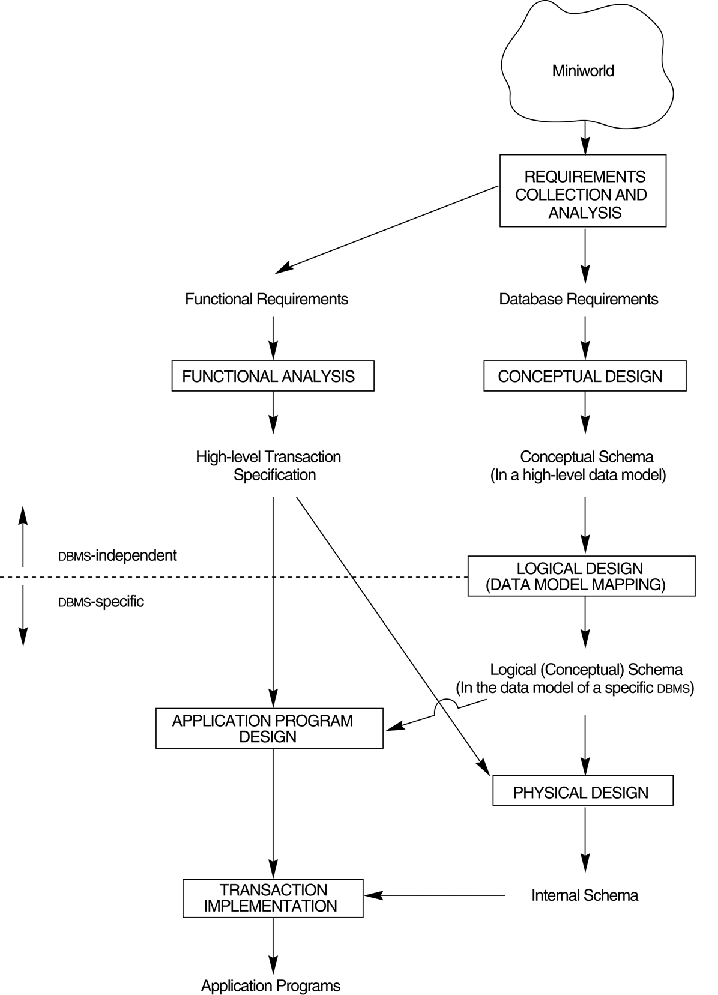
A simplified diagram to illustrate the main phases of database design.

Slide 4
Entity-Relationship Model
An Entity is a person, place, object, event, or concept about which organization wishes to maintain data.
Example
Person : EMPLOYEE,STUDENT
Place : CITY,STATE
Object : MACHINE,AUTOMOBILE
Event : SALE,REGISTRATION
Concept : ACCOUNT,COURSE
Notes:
The conceptual model, located at the abstraction apex, represents a global view of the data. It is an enterprise-wide representation of data as viewed by high-level managers. Using E-R model yields the conceptual schema, which is, in effect, the basic database blueprint.

Slide 5
Entity-Relationship Model
The E-R model is a detailed, logical representation of the data for a business area.
It is expressed in terms of entities in the business, the relationships, and the properties of the entities and relationships.
Uses E-R Diagram

Slide 6
E-R Model Symbols
Strong Entity
Exists independently of other
types. STUDENT, EMPLOYEE
Weak Entity
An entity type whose existence depends on
other entity type. DEPENDENT

Slide 7
E-R Model Symbols
Relationship
Relation ships are glue that holds together
the various components of E-R model.
An association among the instances of
one or more entity types.

Slide 8
E-R Model Symbols
Entity Type Versus Entity Instances
Entity type: EMPLOYEE
EMPLOYEE NUMBER NUMBER(4)
EMPLOYEE NAME ALPHABETS(30)
DATE HIRED DATE
Entity Instances (Two Instances of EMPLOYEE)
1343 5879
Gregory Peck Albert Einstein
08-08-88 09-09-99

Slide 9
E-R Model Symbols
Associative Entity
An entity that associates the instances of one or more
Entity types and contains values that are peculiar to
relationship between those entities.

Slide 10
E-R Model Symbols
EMPLOYEE
CERTIFICATE
COURSE
Employee who may complete one or more courses,
may be awarded more than one certificate.
A course which may have one or more employees
completed it may have many certificates awarded.

Slide 11
E-R Model Symbols
Attribute
property or characteristic of an entity type that is interest to the organization..
\STUDENT: Student_ID,Student_Name
AUTOMOBILE: Vehicle_ID, Color
Initial capital followed by lowercase.
If it has two words, underscore is used to connect
the words a each word starts with a capital letter

Slide 12
Attributes
Flight_No
Date
Captain_Name
FLIGHT

Slide 13
E-R Model Symbols
An attribute that may take on more than one value for a given entity instance
Multi-valued attribute
EMPLOYEE
SKILL

Slide 14
E-R Model Symbols
Derived attribute
An attribute whose value can be calculated
from related attribute values
EMPLOYEE
Years_Employed

Slide 15
E-R Model Symbols
Degree of Relationship
The number of entity types that participate in a relationship.
Degree of Relationship
Unary Relationship
A relationship between the instances of a
single entity type.

Slide 16
Degree of Relationships
Unary Relationship
Is_married_to
PERSON
One-to-one
Manages
One-to-many
EMPLOYEE

Slide 17
Degree of Relationships
Binary Relationship
A relationship between the instances of two entity types

Slide 18
Degree of Relationships
Binary Relationship
EMPLOYEE
Sits_in
CABIN
One-to-one
COMPANY
Contains
DEPARTMENTS
One-to-many
STUDENT
Register_for
COURSE
Many-to-many

Slide 19
Degree of Relationships
Ternary Relationship
A simultaneous relationship among instances of three entity types

Slide 20
Cardinality Constraints
A Cardinality constraint specifies the number of instances of one entity that
can be associated with each instance of another entity.
PATIENT
Has
PATIENT
HISTORY
Mark
Visit 1 history
Visit 1 history
Visit 2 history
Fred

Slide 21
Total Participation
An employee can work in several departments, and a department can have several employees. This is called as total participation.
101
1/1/96
d1
102
2/2/97
d2
3/5/98
103
d3
2/5/99
Employees
Works_in
Departments
Total Participation
Many to Many
Total Participation

Slide 22
Partial Participation
Consider another example where each department as at most one manager, although a single employee is allowed to manage more than one department. The restriction that each department has at most one manager is an example of a key constraint..
2/2/97
d1
101
3/5/98
d2
102
103
2/5/99
d3
Employees
Managers
Departments
Partial Participation
One to Many
Total Participation

Slide 23
Thank you
Visit us at www.techmahindra.com
Disclaimer
Tech Mahindra Limited, herein referred to as TechM provide a wide array of presentations and reports, with the contributions of various professionals. These presentations and reports are for informational purposes and private circulation only and do not constitute an offer to buy or sell any securities mentioned therein. They do not purport to be a complete description of the markets conditions or developments referred to in the material. While utmost care has been taken in preparing the above, we claim no responsibility for their accuracy. We shall not be liable for any direct or indirect losses arising from the use thereof and the viewers are requested to use the information contained herein at their own risk. These presentations and reports should not be reproduced, re-circulated, published in any media, website or otherwise, in any form or manner, in part or as a whole, without the express consent in writing of TechM or its subsidiaries. Any unauthorized use, disclosure or public dissemination of information contained herein is prohibited. Unless specifically noted, TechM is not responsible for the content of these presentations and/or the opinions of the presenters. Individual situations and local practices and standards may vary, so viewers and others utilizing information contained within a presentation are free to adopt differing standards and approaches as they see fit. You may not repackage or sell the presentation. Products and names mentioned in materials or presentations are the property of their respective owners and the mention of them does not constitute an endorsement by TechM. Information contained in a presentation hosted or promoted by TechM is provided “as is” without warranty of any kind, either expressed or implied, including any warranty of merchantability or fitness for a particular purpose. TechM assumes no liability or responsibility for the contents of a presentation or the opinions expressed by the presenters. All expressions of opinion are subject to change without notice.

